Slide 1

Master the Swiss Army Knife of Web Pentesting: Burp Suite 101
If you're serious about Web Application Security, there is one tool you simply cannot ignore: Burp Suite.
Whether you are a Bug Bounty Hunter or a Security Engineer, mastering the proxy is your first step to finding critical vulnerabilities. Here is a quick breakdown of how to get up and running:

Slide 2
1️⃣ The Setup
Install
The Proxy
Certificates
Download the Community Edition (it's free!).
Set your browser (or use the built-in Burp browser) to route traffic through 127.0.0.1:8080.
Import the Burp CA certificate so you can intercept HTTPS traffic without errors.

Slide 3
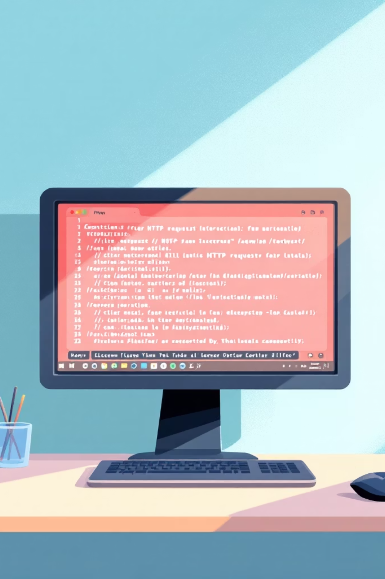



2️⃣ Intercepting Traffic
Go to the Proxy Tab
Navigate to the Proxy Tab → Intercept is ON.
Refresh Your Target Page
Refresh your target page.
The Magic Happens
You now see the raw HTTP request before it hits the server. This is where the magic happens.

Slide 4
3️⃣ The "Big Three" Modules
Repeater
Intruder
Decoder
Send a single request here to tweak parameters and resend it as many times as you want. Perfect for testing IDOR or XSS.
The fuzzer. Use this for brute-forcing logins or testing every input field for vulnerabilities.
Quickly convert Base64, URL encoding, or Hex without leaving the app.

Slide 5

Pro Tip 💡
Use the Target Scope! Always define your target domain so you don't accidentally intercept traffic from your background apps or other websites.
🎯 Defining your Target Scope keeps your testing focused, clean, and professional — a habit every serious security engineer should build from day one.

